Slide 1
LogStat
Reporting and Logging Software for VisioStats
GKE, Original Rev 1, July 2013
First implementation: Rev 2 Aug 25, 2013
Added mods to VS-800: Rev 3: Sep 2, 2013
GK Added pictures, Rev 4: Sep 3, 2013

Slide 2
Introduction to LogStat
LogStat is a program which,
Connects with multiple VisioStats
Collects and displays received information in real-time.
Computes statistics (ave, min, max) every minute or so.
Stores the statistics in a Database for later processing
VisioStat
5.3
1
USB cable
VisioStat
SupportStat
JunctionStat
8.6
2
Laptop
WiFi
string
USB hub
LogStat
SQLExpert
VisioStat
10.
N
CheckVS

Slide 3
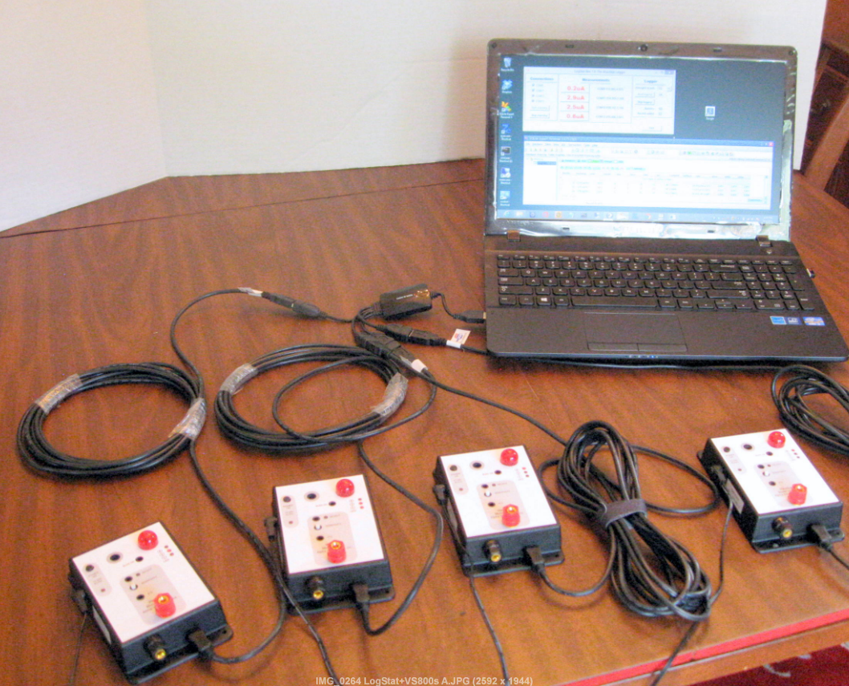
…and here it is

Slide 4
What is included…
CheckVS
A program which can be used to quickly setup the connections between the Laptop, Hub and VisioStats
LogStat
A program to connect with VisioStats, display and log received information
Comms
A utility which displays the USB/Comm ports of the laptop
TermPro or PuTTY (freeware)
Terminal program(s) to inspect/debug incoming data
SQLExpert (free version)
Browser of the SQLite databases.

Slide 5
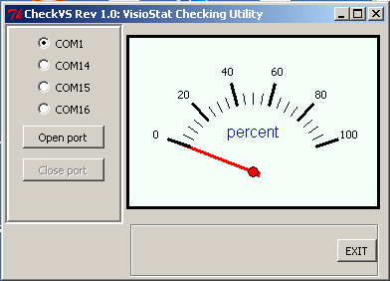
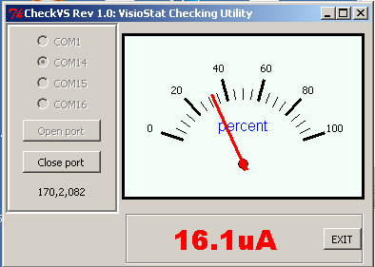
CheckVS
2. COM14 selected
3. [Open port] pressed
5. Real-time display as a percent of the full scale
1. USB comm ports are listed when the program starts
4. Real-time display of VisioStat in microAmperes (automatically adjusted)
4. Real-time display of raw data as received from VisioStat at port COM14
Start program by clicking CheckVS.py in the \LogStat directory, or
type “CheckVS” while at D:\LogStat\

Slide 6
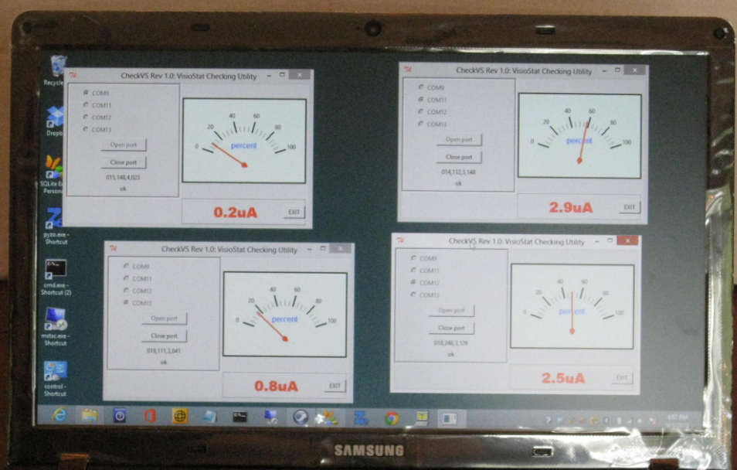
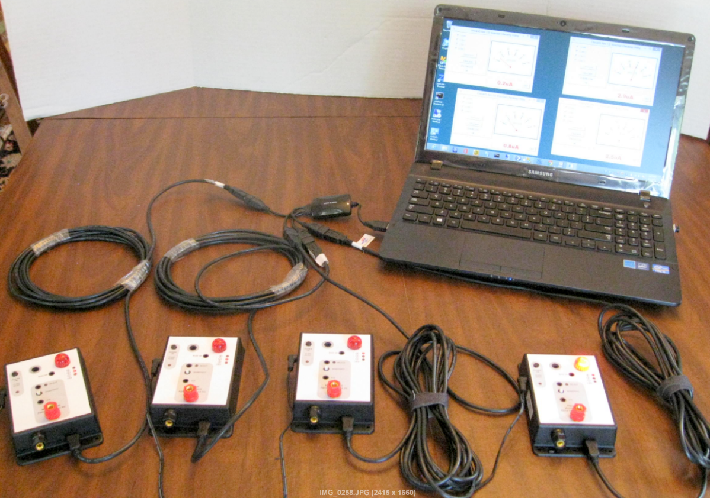
CheckVS connected to four VS-800s

Slide 7
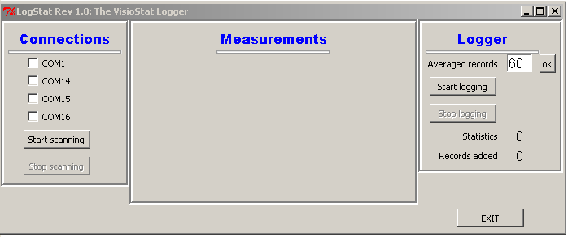
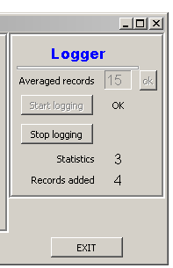
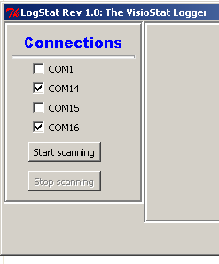
LogStat
1. Start by clicking ‘LogStat.py’ in the \LogStat directory
2. All USB ports are discovered and displayed
Placeholder of real-time measurements (after [Start scanning] is pressed]
3. Select the USB ports where VisioStats are connected to
4. Press [Start scanning]
5. You may select the number of records to compute statistics. Must be greater than 10; default value is 60
6. Statistics counter increments fro one (1) to [Averaged Records]
7. A record is written to the database when statistics reach [Averaged Records]. [Records added] indicates the number of recors added to the database since [Start Logging ] was pressed.

Slide 8
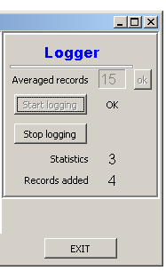
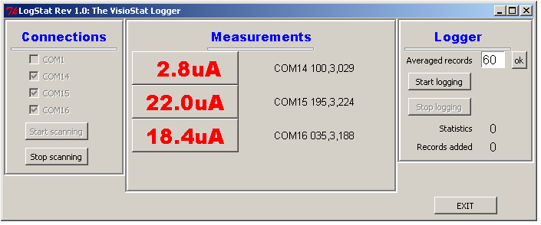
LogStat (cont.)
9. Raw VisioStat data
10. Statistics are computed and stored into the database
8. Real-time data displays in micro-Amperes
8

Slide 9
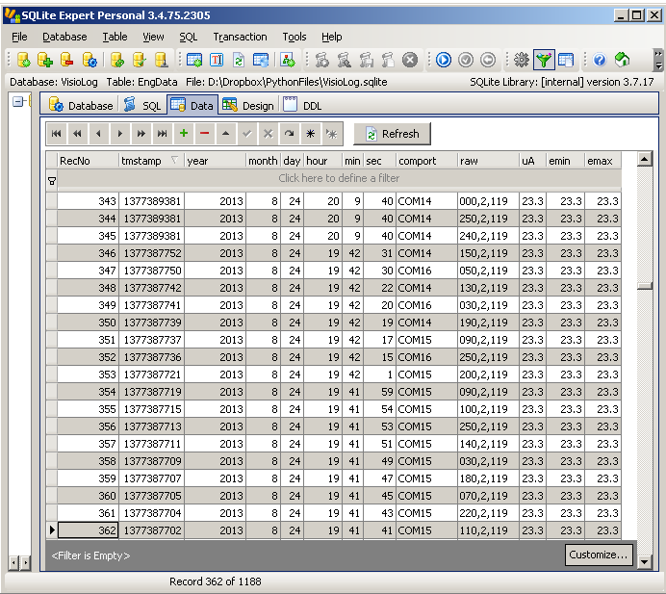
Database Browsing
1. Use the “SQLite Expert” to browse the database
2. Data from all USB ports are stored into the database
3. The time-stamp of data collection (and statistics) is stored
4. The average (uA) value, the minimum value (emin), and the maximum value (emax) are stored
5. The database can be
Can be ‘read’ while LogStat ‘writes’ data
Sorted in any fashion
Queried using SQL
6. Other programs can be written to process the data

Slide 10
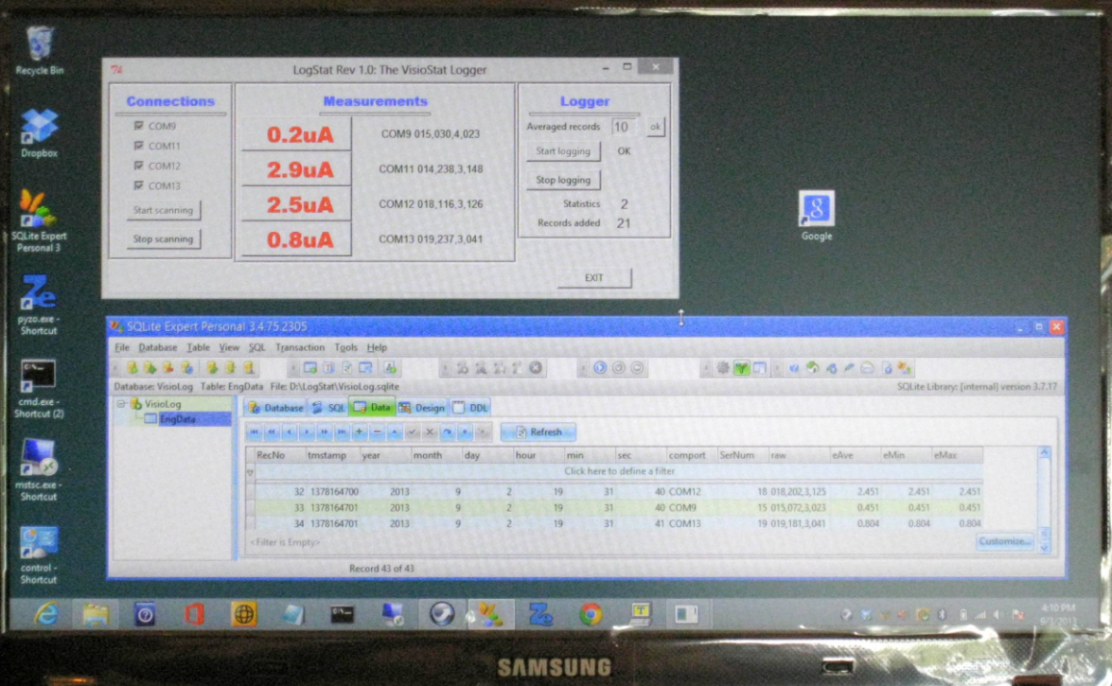
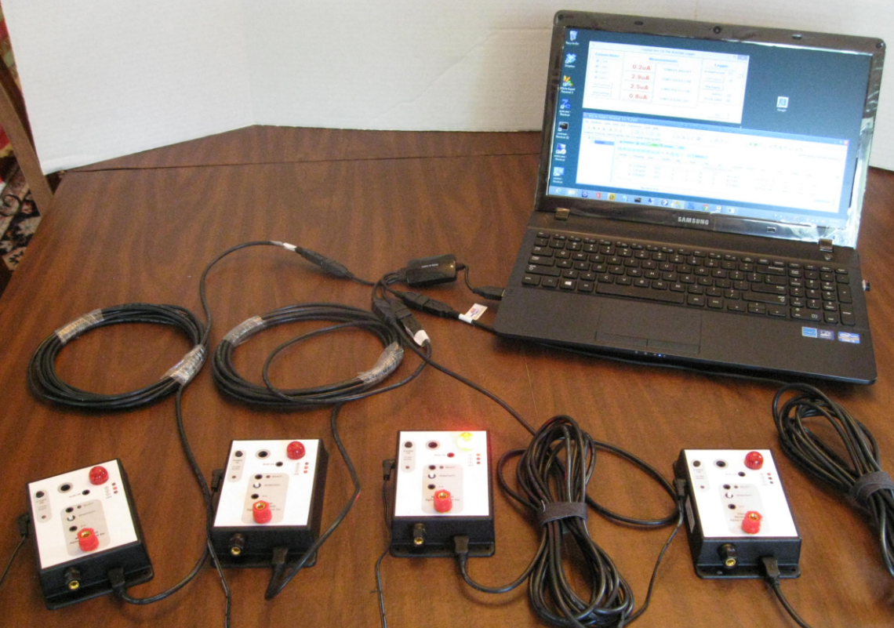
LogStat in action…

Slide 11



Using the System
Required programs
Tera Term Pro (or other Terminal Program)
Can be started from any location
Located in the Quick Link Bar
SQLite Expert (or other SQLite browser)
Can be started from any location
Located in the Quick Link Bar
Cmd (.cmd)
Opens a command window in the D:\LogStat directory
Comms (.py)
To check if USB ports have been connected
Located in the D:\LogStat directory. Type Comms there.
LogStat (.py)
Starts the LogStat program
Located in the D:\LogStat directory. Type LogStat there.
Directories
D:\LogStat all necessary files (as above)
D:\DropBox\LogStatDev: George’s dev directory, don’t modify

Slide 12
Installation Hints
Wire all VS-800s first
To the power supplies
To the USB ports or HUB
Turn the power on
Check connectivity using Comms
If you do not see the expected COMM ports redo (1)
Use CheckVS to verify that each port works correctly
If not, exit CheckVS and start TeraTerm
Press ^C twice, and reconfigure VisioStats
Start LogStat
Unless (1)…(3) have been completed successfully, do not attempt to run LogStat

Slide 13
Changes to VS-800 (built 9/2/2013)

Slide 14
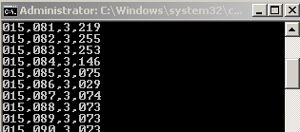
VS-800 enhancements
SENSITIVITY Adjustment
SENSITIVITY can be adjusted without pressing the SELECT pushbutton. For a given current flow, adjust until LED1+LED2 are ON and LED4 is OFF.
USB Connection
Serial settings are 9600 baud, 8 bits, no parity. Both transmit and receive are active.
Added Serial Number Reporting
The new format is: NNN,CCC,S,MMM
where:
NNN is the S/N of the device
CCC is a wrap around record counter from 0…255
S is the sensitivity 0…7
MMM is the measurement from 0…255 (full scale). Use the Measurements Scale to find the current measured.
Measurements are reported per second, independently of the sensitivity settings.

Slide 15
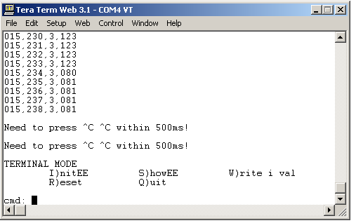
VS-800 Terminal Mode
Now you can a serial TERMINAL to VS-800
To do so, start your favorite terminal program, and while the instrument is reporting, press ^C followed by ^C within half a second.
Examples follow

Slide 16
Examples of Terminal Mode Commands
Basically you can modify VS-800’s configurations remotely and reboot the device.
cmd: S
Show EEPROM parameters
cmd: r
RESET. Equivalent to POWER OFF followed by POWER ON.
cmd: q
Quit TERMINAL mode, back to NORMAL operation.
cmd: w 0 2
Enable TEST mode. (Default is disabled.)
cmd: w 0 4
Enable LINEAR scale for the LEDs. (Default is disabled.)
cmd: w 2 34
Change SERIAL NUMBER to 34

Slide 17
Summary of Modes of Operation
NORMAL MODE
Measure current, Enable FLASHER, Enable BUZZER (if the BUZZ ON pushbutton is pressed), Transmit to the USB/UART measurements every second
CONFIGURATION MODE
Useful to RESET to VisioStat to the default settings
Useful to enable the TEST MODE
While in CONFIG MODE, the VisioStat is NOT running.
To enable the CONFIG MODE,
Press POWER OFF
Press and hold SELECT and press POWER ON concurrently. Release SELECT.
Select 0 (RESET) or 1 (TEST MODE) using the SENSITIVITY
Press POWER OFF, then POWER ON.
TERMINAL MODE
Useful to interact with the VisioStat remotely using a terminal over USB/RS-232
Used to modify parameters and change serial numbers
To enable TERMINAL MODE, press ^C twice while in NORMAL MODE
While in TERMINAL MODE, the VisioStat is NOT running.
To quit back to NORMAL MODE, press “q” followed by RETURN
TEST MODE
Useful to simulate current readings without connecting anywhere.
To enable TEST MODE, use either the CONFIG MODE or TERMINAL MODE (w 0 2 command).
You can simulate an input current from 0 to maximum full scale using the SENSITIVITY potentiometer.
To return to NORMAL mode, use either the CONFIG MODE or TERMINAL MODE (w 0 0 command)

Slide 18
State Diagram of Modes of Operation
OFF
CONFIG MODE
NORMAL MODE
TEST MODE
TERMINAL MODE

Slide 19
Appendix: Related Python Modules

Slide 20
Organization
LogStat
LogStat.py
CheckVS.py
Comms
VisioLog.sqlite
classFrames.py
classVisioStat.py
classDataBase.py
classComm1.py
classMetter.py
PYZO
Files relating to LogStat utilities
Main program for LogStat
Utility to check VS connectivity
Command line utility to list comm ports
Database maintained by VisioStat
LogStat.py support – GUI frames
LogStat.py support – VisioStat access
LogStat.py support – Database access
CheckVS.py support – GUI frames and I/O
CheckVS.py support – Analog meter GUI
Python libraries (do not modify!)

Slide 21
Code hierarchy
classFrames
Comms.
Measure.
Logger.
classDataBase
logDB.
LogStat
main()
classVisioStat
VisioStat.
toeng()
classComm1
Comm1.
classDataBase
logDB.
CheckVS
main()
classMetter
Meter.
Comms
main()

